Slide 1

ANGULAR 4

Slide 2
Routing
Routing Essentials
Essential Routing Code
Sending and Receiving Route Parameters
Basics of Route Resolvers
Route Guards
Applying Route Guards
Child Routes

Slide 3
ROUTING ESSENTIALS
Routing allows our aplication to navigate between diferente Components, passing passing parametera where needed.

Slide 4
ROUTING ESSENTIALS
Index.html
<base href=“/”>
We need the <base> element.
Required for routing to work properly

Slide 5
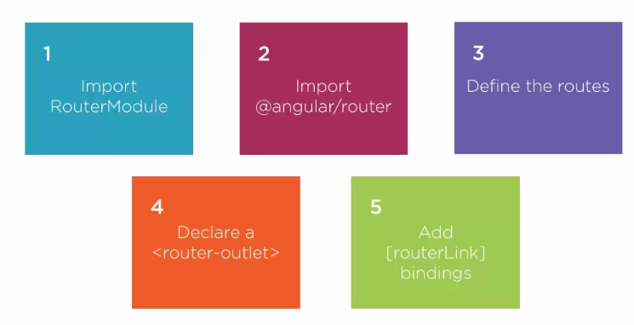
ROUTING ESSENTIALS
5 steps to use routing

Slide 6
ESSENTIAL ROUTING CODE
App-routing.module.ts
Import { NgModule } from ‘@angular/core’;
Import { Routes, RouterModule } from ‘@angular/router’;
Const routes: routes = [
{ path: ‘’, pathMatch: ‘full’, redirectTo: ‘ships’ },
{ path: ‘ships’, component: shipsListComponent },
{ path: ‘ship/:id’, component: shipComponent },
{ path: ‘**’, pathMatch: ‘full’, component: PageNotFoundComponent }
];
@NgModule({
imports: [RouterModule.forRoot(routes)],
exports: [RouterModule]
})
Export class AppRoutingModule { }
We define a routing Module, and import it into the app Root.

Slide 7
ESSENTIAL ROUTING CODE
app.module.ts
Import { AppComponent’ from ‘./app.component’;
Import { ApproutingModule } from ‘./app-routing.module’;
@NgModule({
imports: [ BrowserModule, AppRoutingModule ],
declarations: [ AppComponent]
bootstrap: [AppComponent]
})
Export class AppModule { }
Importing the routing module

Slide 8
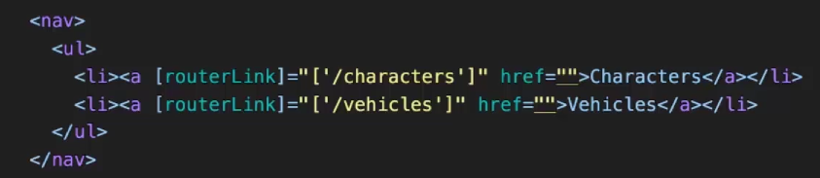
ESSENTIAL ROUTING CODE
app.component.html
Link Parameters
The view is going to be placed here.
The RouterLink directive navigates to a route path

Slide 9
Demo

Slide 10
SENDING AND RECEIVING ROUTE PARAMETERS
Import { NgModule } from ‘@angular/core’;
Import { Routes, RouterModule } from ‘@angular/router’;
Const routes: routes = [
{ path: ‘’, pathMatch: ‘full’, redirectTo: ‘ships’ },
{ path: ‘ships’, componente: shipsListComponent },
{ path: ‘ship/:id’, componente: shipComponent },
{ path: ‘**’, pathMatch: ‘full’, componente: PageNotFoundComponent }
];
@NgModule({
imports: [RouterModule.forRoot(routes)],
exports: [RouterModule]
})
Export class AppRoutingModule { }

Slide 11
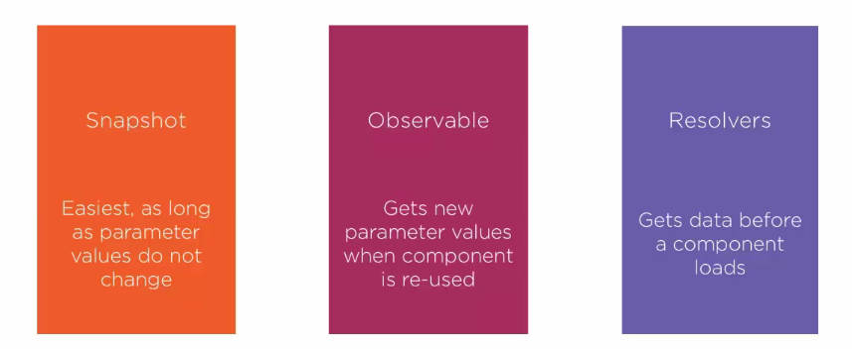
SENDING AND RECEIVING ROUTE PARAMETERS

Slide 12
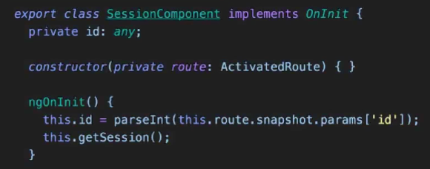
SENDING AND RECEIVING ROUTE PARAMETERS
SNAPSHOT

Slide 13
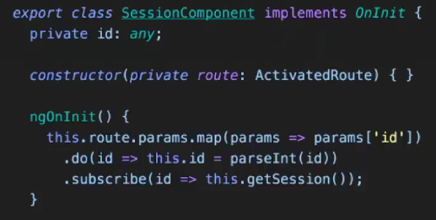
SENDING AND RECEIVING ROUTE PARAMETERS
Observables

Slide 14
SUBSCRIBING TO ROUTE PARAMETERS
Demo

Slide 15
BASICS OF ROUTE RESOLVERS
Resolvers
Get data prior to traversing the route

Slide 16
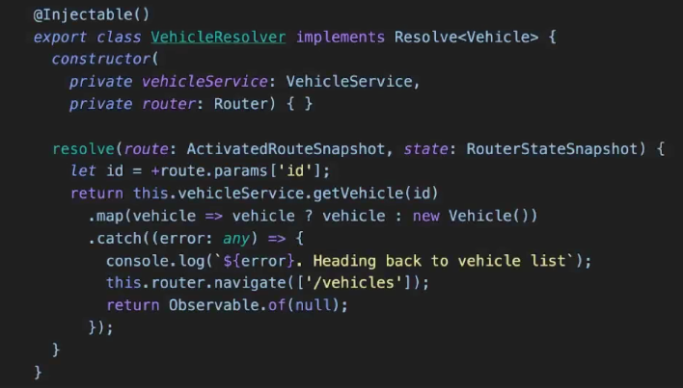
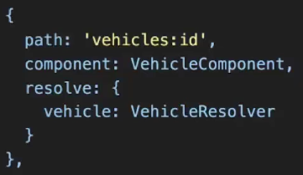
BASICS OF ROUTE RESOLVERS
Vehicle-resolver.service.ts
App-routing.module.ts

Slide 17
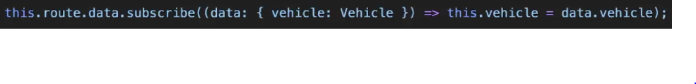
BASICS OF ROUTE RESOLVERS
..component.ts

Slide 18
ROUTE GUARDS
Guards
Guards allow us to make a decision at key points in the routing lifecycle and either continue, abort or take a new direction.

Slide 19
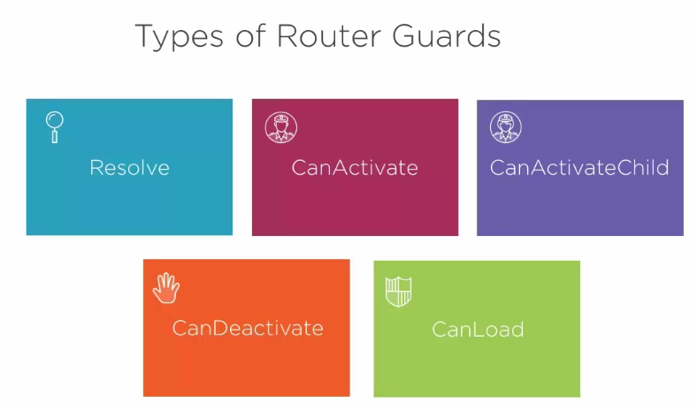
ROUTE GUARDS

Slide 20
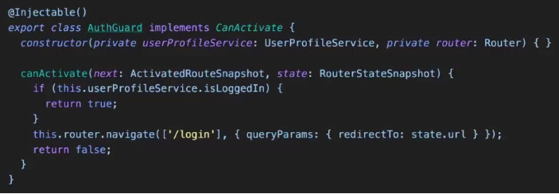
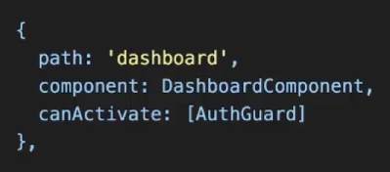
ROUTE GUARDS
Auth-guard.service.ts
App-routing.module.ts

Slide 21
APPLYING ROUTE GUARDS
Demo

Slide 22
CHILD ROUTES
Child Routes
A Component may define routes for other Components. This creates a series of hierarchical child routes.

Slide 23
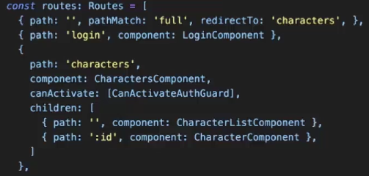
CHILD ROUTES
App-routing.module.ts

Slide 24
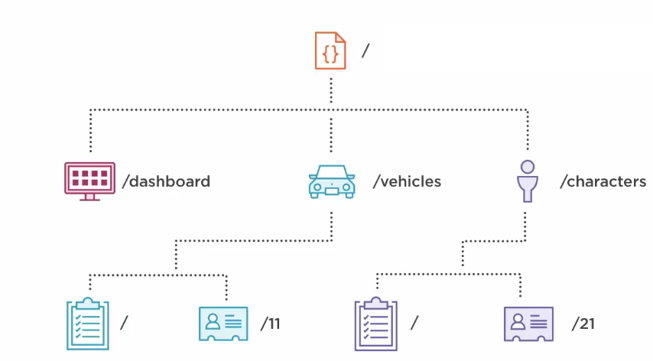
CHILD ROUTES

